Slide 1

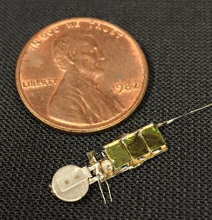
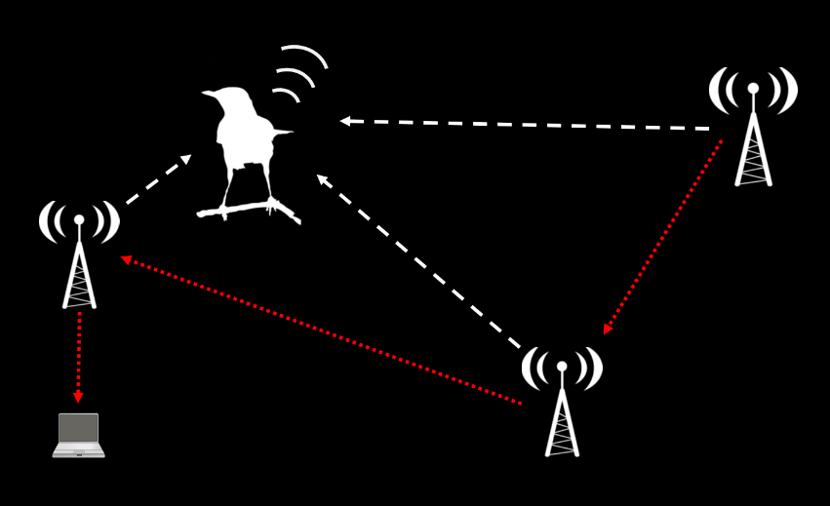
AMRUPT (Animal Movement Research Using Phase-based Trilateration)

Slide 2
This week's meeting: proposal discussion
Define the AMRUPT Problem
Project Proposal
Khandani, 2005

Slide 3
Statement of Problem: the "why?"
Background information:
Relevance or importance of problem
Background information to educate the reader about concepts relevant to the work
Previous related work by others—literature review with credible sources
Detailed problem description, as you now understand it

Slide 4
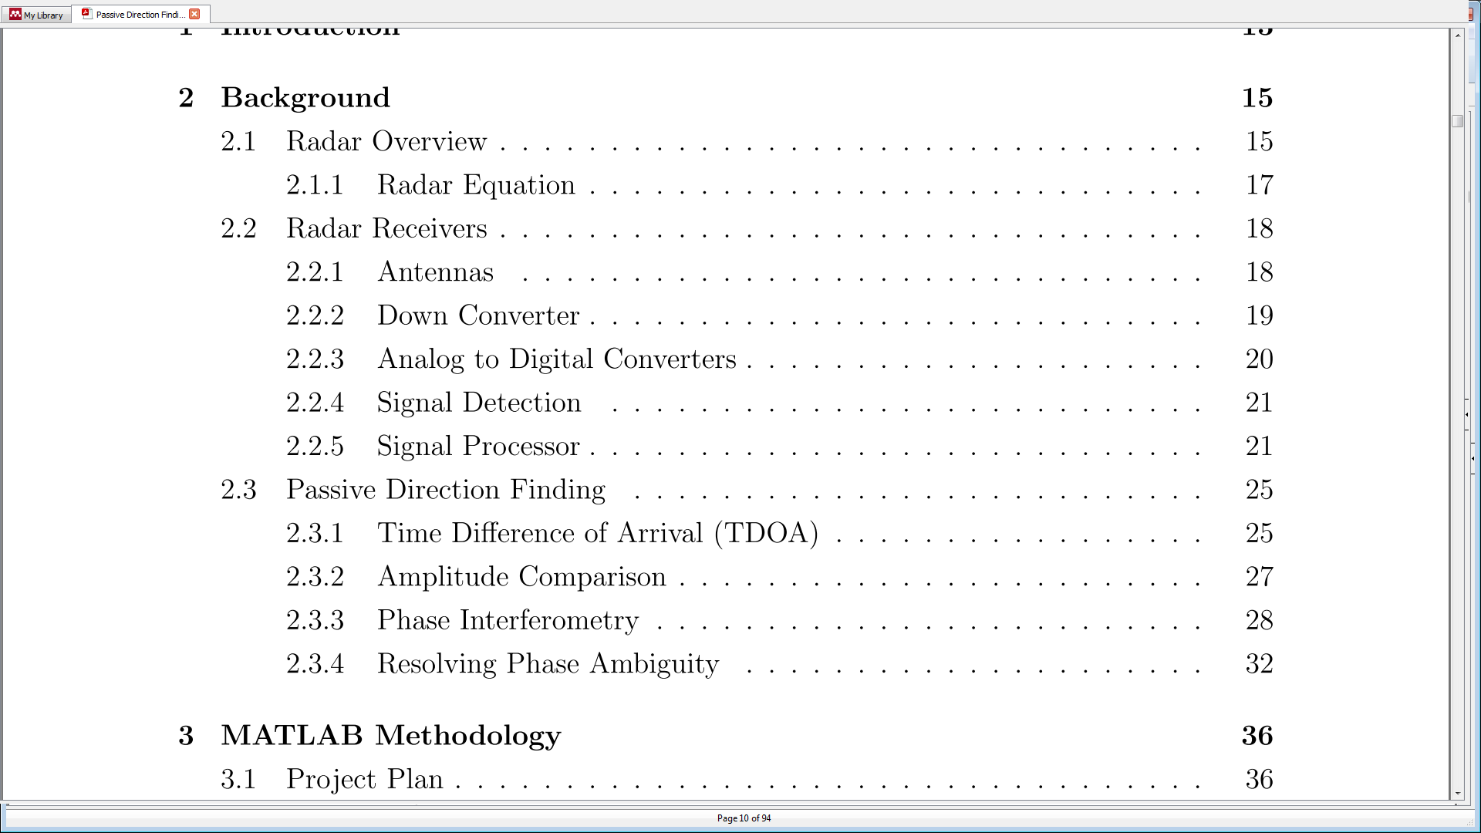
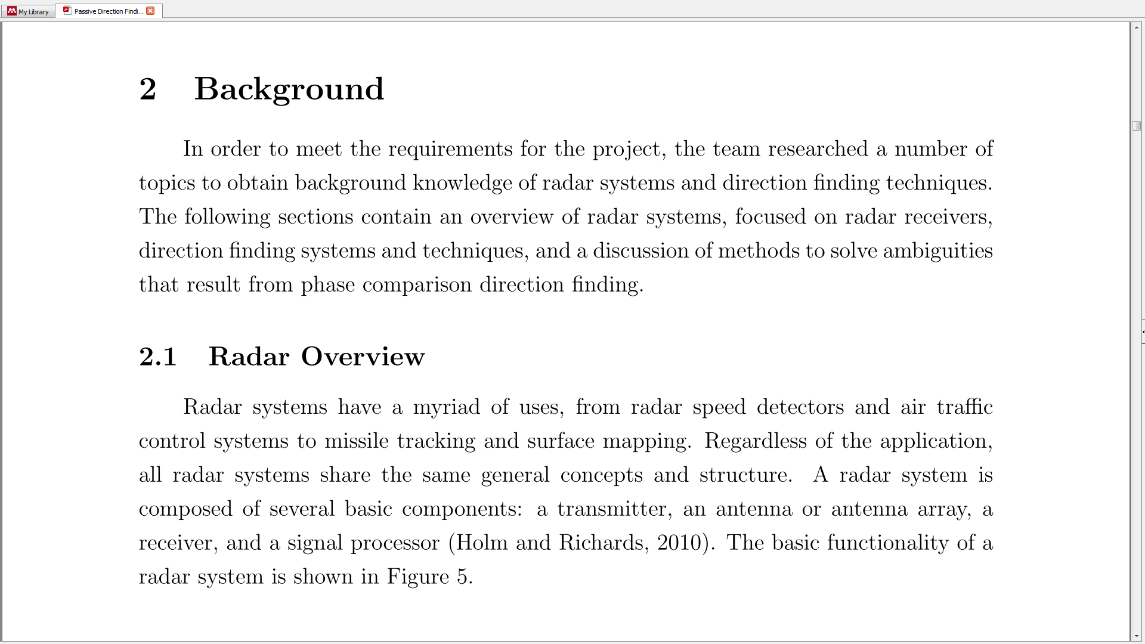
Statement of Problem: the "why?"

Slide 5
Objectives: the "what?"
Objectives list
Ignore advice to limit to 4 points. We need to fully define the “what”
Forward compatibility: Must be compatible with and adaptable to a multi-frequency-phase-integer-disambiguation approach for future versions

Slide 6
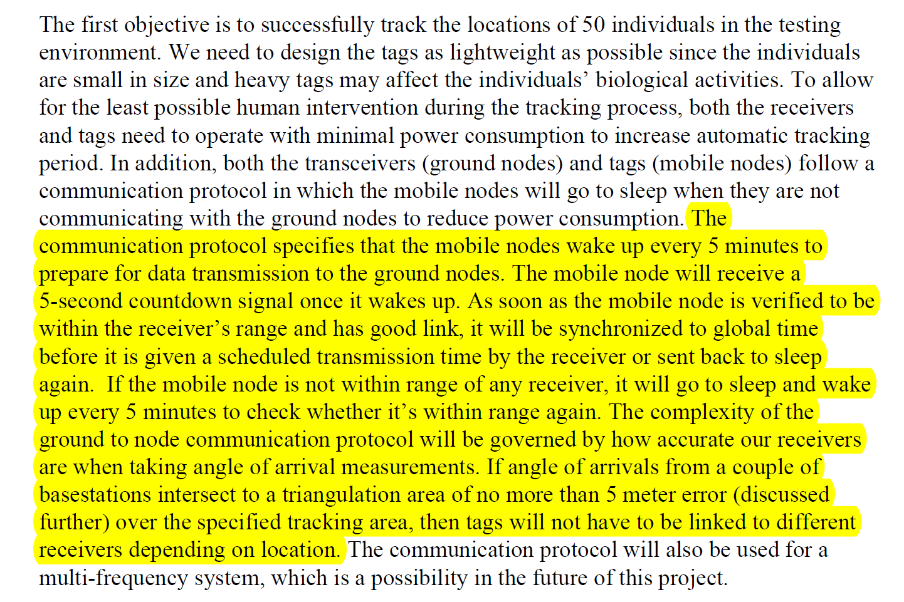
Objectives: the "what?"
Don’t detail the “how” until you get to the technical approach section

Slide 7
Technical approach: the "how?"
What are the proposed solutions to achieve the previously outlined objectives for this project?
Refer (explicitly) to workable solutions from others’ previous work
Explain design tradeoffs, constraints
How will you analyze the performance of your solution? How will that analysis inform design choices?
Explicitly detail which tests you will perform to inform which decisions
Explain the what the test result values would mean? I.e. How will these values influence the design process??
Example: From “study A,” which used a sampling rate of B to achieve spatial resolution C we extrapolated, using equation D, that we would need a sampling rate of E to achieve our specified resolution of C’. Test F will evaluate whether we are within our target resolution of C’. If test F reveals that our resultion is <C’, we will increase sampling rate using equation G, developed by “Study H.”

Slide 8
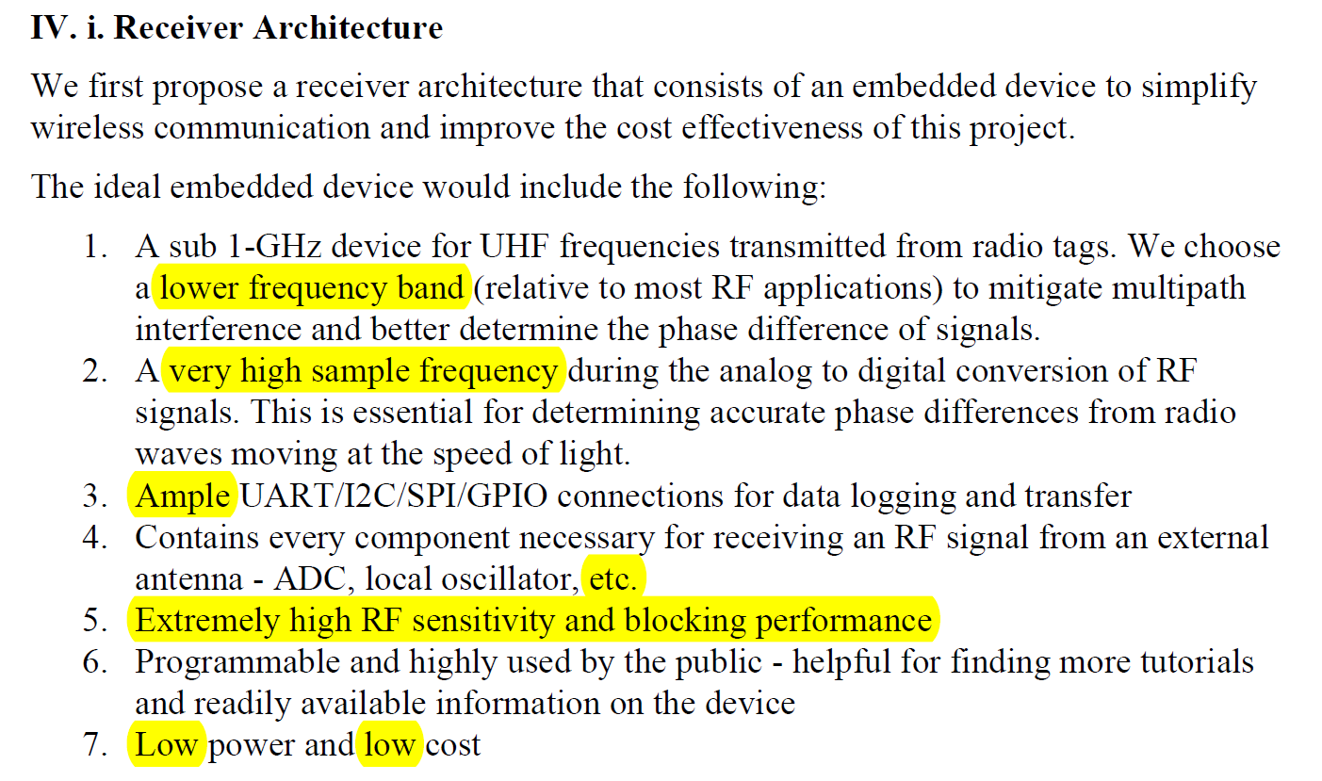
Technical approach: the "how?"
Be specific!

Slide 9
Technical approach specifics
UHF = 300 MHz – 1 GHz → system was to operate on 150 MHz (Why?)
“With this system, only offsets from the antenna geometry or the wire lengths/connectors from each antenna to the switch could contribute to phase difference errors between each antenna, eliminating the need for Equalization with LFMs.” How will we know if this actually poses a problem?
“This setup would require the use of multiple GPIO ports and multiple chained switches to accomplish our goal of having 3 antennas.” Figure showing proposed architecture. Is this really the best way to do this? No 3 output relays suitable? What other considerations are important for the switch [Isolation and Insertion loss]? How will these effects be evaluated?!
“SPI has the fastest data transfer rate. UART is easiest to set up. Without knowing the maximum data transfer rate, we choose to use UART for test purposes.” We CAN know the maximum data transfer rate required, through simulation and modeling.
“We will run a program on Raspberry-pi to log those [the AOA] data.” If this is part of the proposal, be explicit about how this will work.

Slide 10
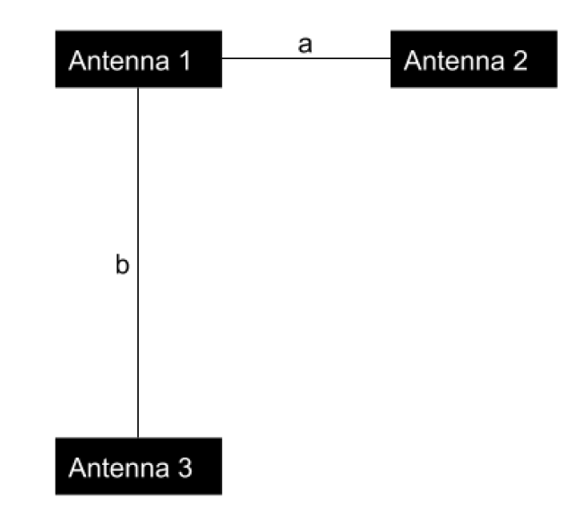
Technical approach specifics: Antenna array
“The simplest way to remove ambiguity is to place the interferometer’s two antennas less than λ/2 apart; however, this cannot be used for our application.”
“Comparing the phase difference from antennas 1 and 2 to the phase difference of antennas 2 and 3” What’s wrong?
Antenna array as designed, is not equally sensitive in all directions: 3-to-1 phase difference calculations could ameliorate this.

Slide 11
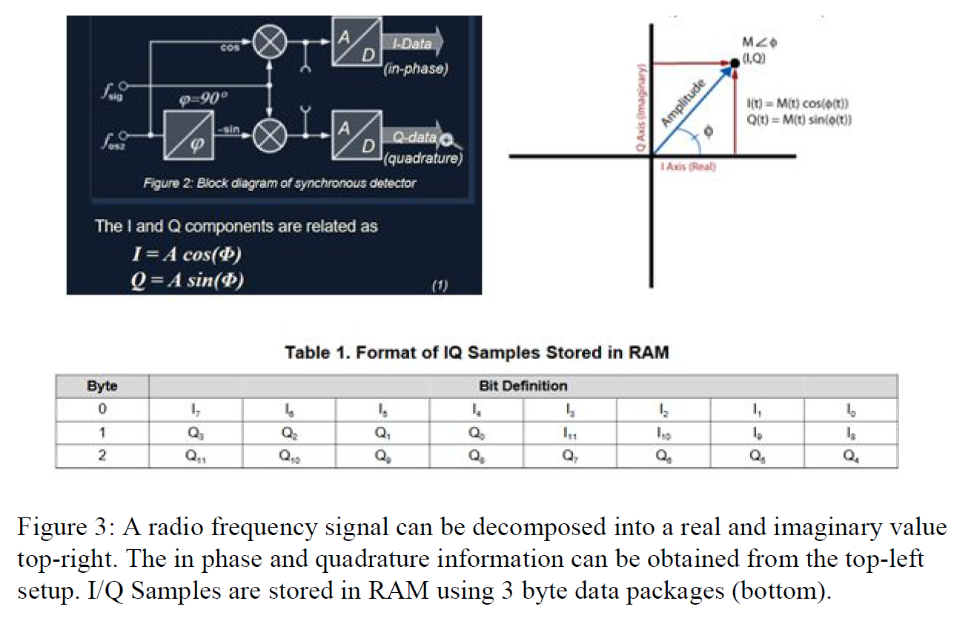
Technical approach specifics: AOA estimation
This is not the setup being proposed!

Slide 12
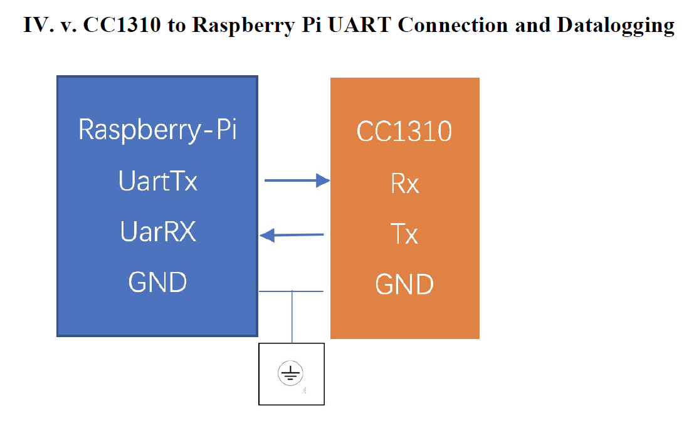
Technical approach specifics
This is not the correct pinout for the CC1310 (Rx and Tx pins are the RF pins)

Slide 13
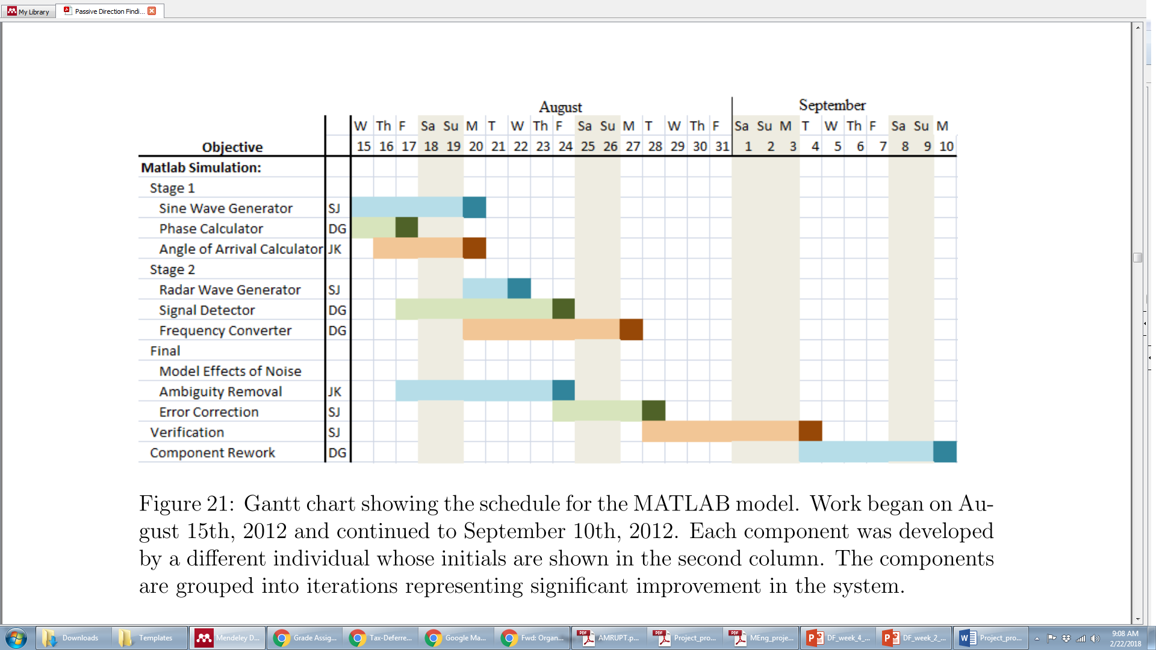
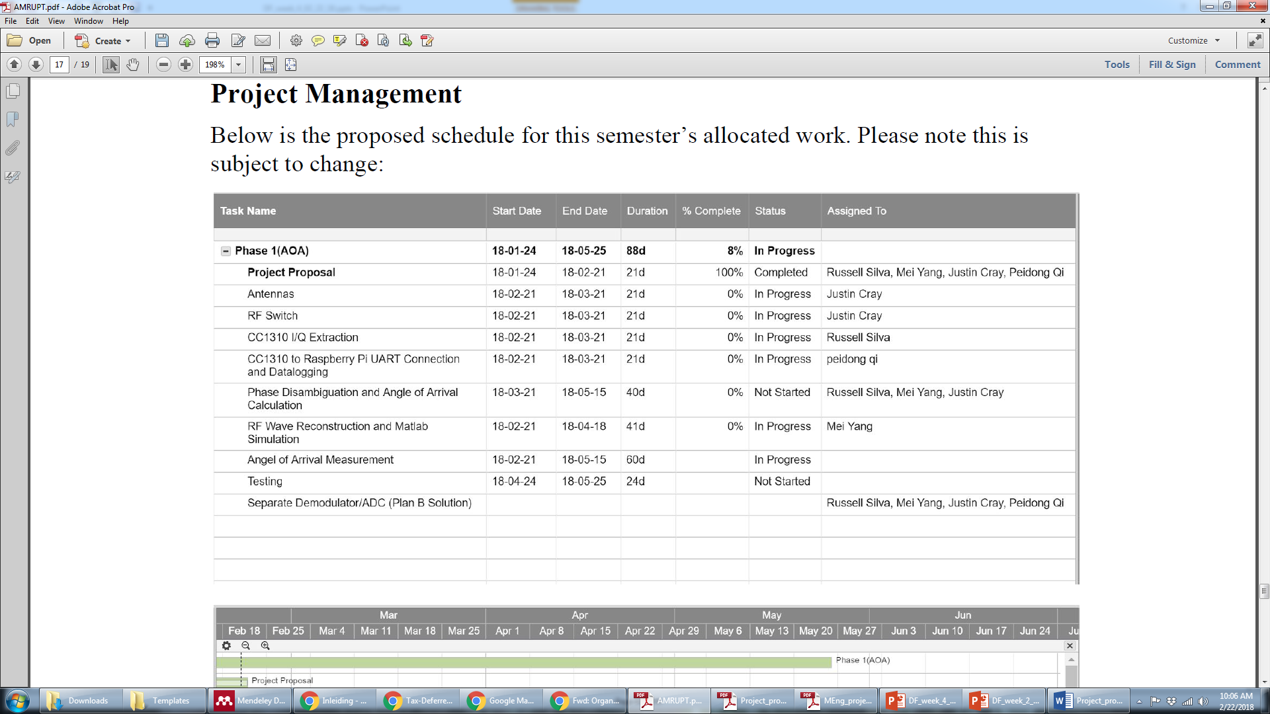
Management plan
Explain your Gantt chart in the text of your document!!
Be specific!

Slide 14
Management plan
Milestones? Phases?
Explain phases of project: How are you managing the work? How are you approaching task allocation?
Example 1: What does “Antennas” mean? What will be accomplished?
Example 1: How does “Matlab Simulation” fit in? Why is it there?
Example 2: “Testing” what? When? What does it accomplish?

Slide 15
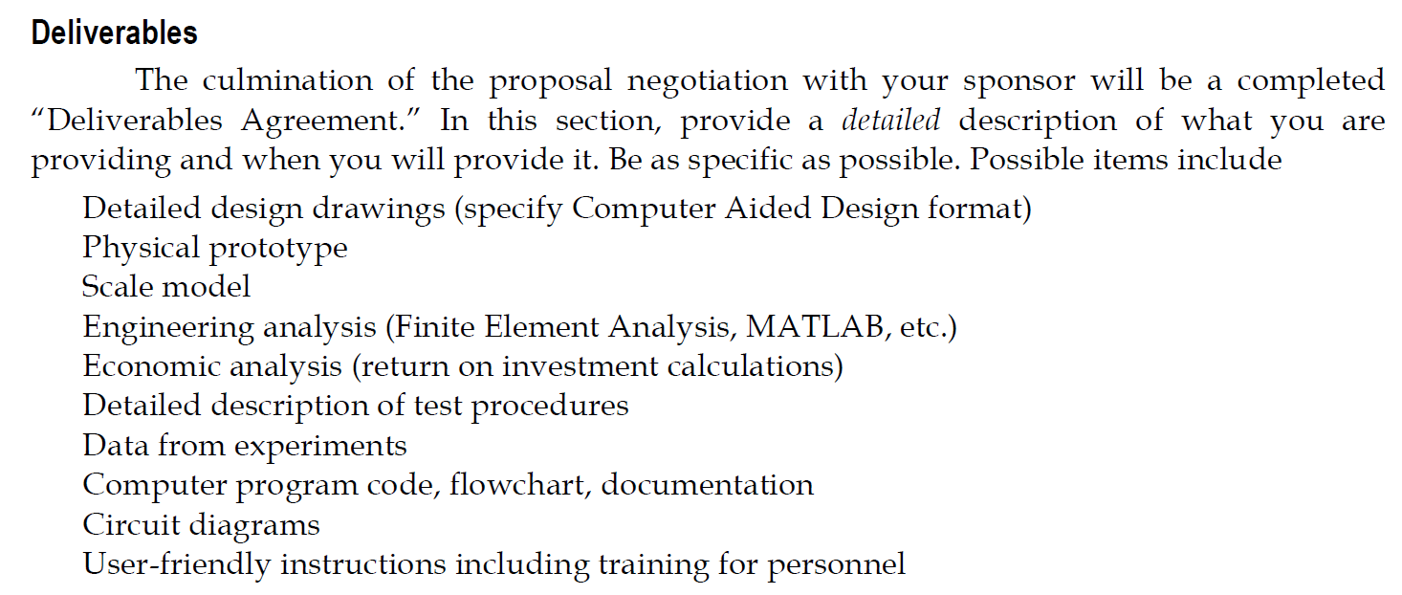
Deliverables??

Slide 16
Formatting and citations
Issues/Points of clarification:
Label ALL figures
Discuss any figure or table in the proposal. Don’t include anything you’re not going to discuss.
Don’t use others’ figures or equations without attribution!! This is plagiarism!

Slide 17
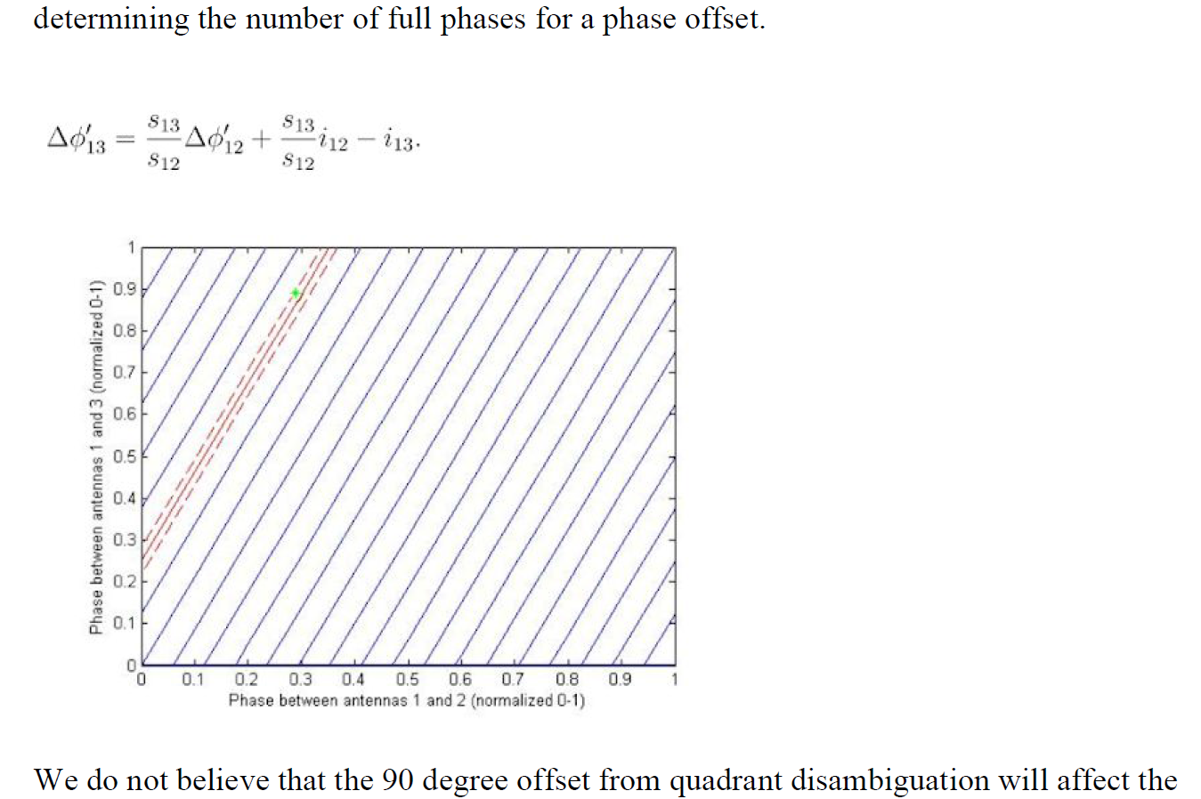
Formatting and citations

Slide 18
Formatting and citations
Issues/Points of clarification:
Label ALL figures
Discuss any figure or table in the proposal. Don’t include anything you’re not going to discuss.
Don’t use others’ figures or equations without attribution!! This is plagiarism!
Check carefully for typos, unclear language: these can lead to total misinterpretation!
Define acronyms and terms:
Example: “…eliminating the need for Equalization with LFMs” Explain what this means

